Slide 1
Training quantum circuit
26/6/2021

Slide 2
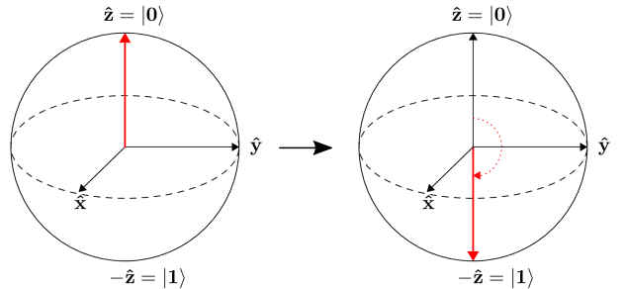
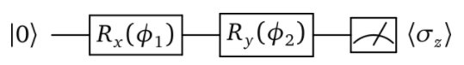

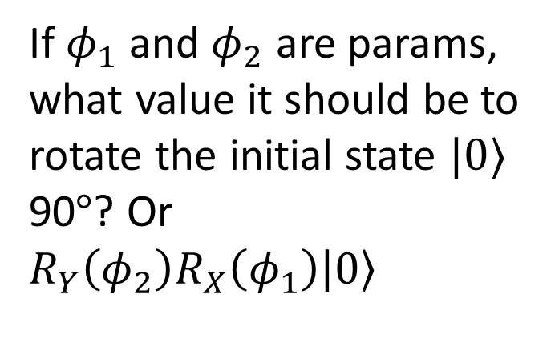
Rotation gate
If $φ_{1}$ and $φ_{2}$ are params, what value it should be to rotate the initial state $|0⟩$ 90$°$? Or $R_{Y}\left(φ_{2}\right)R_{X}\left(φ_{1}\right)\left|0\right\rangle$

Slide 3
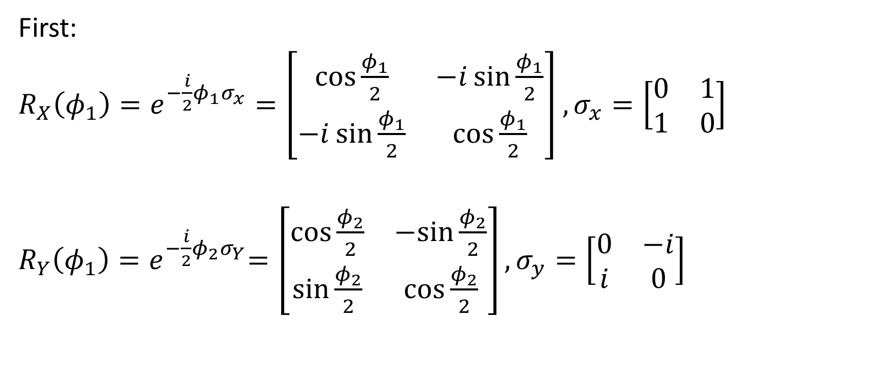
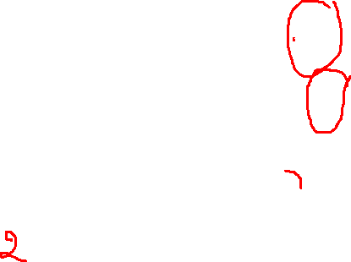
Rotation gate
First:
$R_{X}\left(φ_{1}\right)=e^{−\frac{i}{2}φ_{1}σ_{x}}=\left[\begin{matrix}\cos{\frac{φ_{1}}{2}} & −i\sin{\frac{φ_{1}}{2}} \\ −i\sin{\frac{φ_{1}}{2}} & \cos{\frac{φ_{1}}{2}}\end{matrix}\right]$ $,σ_{x}=\left[\begin{matrix}0 & 1 \\ 1 & 0\end{matrix}\right]$
$R_{Y}\left(φ_{1}\right){=e}^{−\frac{i}{2}φ_{2}σ_{Y}}=\left[\begin{matrix}\cos{\frac{φ_{2}}{2}} & −sin{\frac{φ_{2}}{2}} \\ \sin{\frac{φ_{2}}{2}} & \cos{\frac{φ_{2}}{2}}\end{matrix}\right],σ_{y}=\left[\begin{matrix}0 & −i \\ i & 0\end{matrix}\right]$

Slide 4
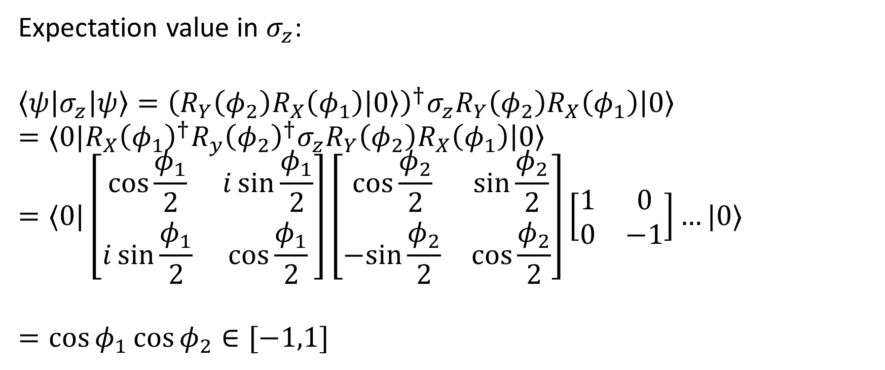
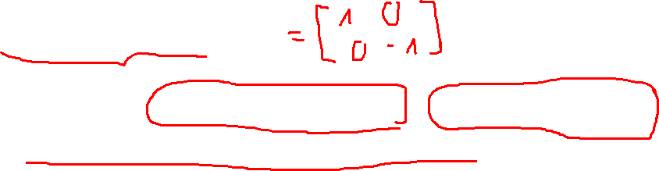
Rotation gate
Expectation value in $σ_{z}$:
$$\left\langle ψ\left|σ_{z}\right|ψ\right\rangle ={\left(R_{Y}\left(φ_{2}\right)R_{X}\left(φ_{1}\right)\left|0\right\rangle \right)}^{†}σ_{z}R_{Y}\left(φ_{2}\right)R_{X}\left(φ_{1}\right)\left|0\right\rangle$$
$$=⟨0|R_{X}{\left(φ_{1}\right)}^{†}R_{y}{\left(φ_{2}\right)}^{†}σ_{z}R_{Y}\left(φ_{2}\right)R_{X}\left(φ_{1}\right)\left|0\right\rangle$$
$$=⟨0|\left[\begin{matrix}\cos{\frac{φ_{1}}{2}} & i\sin{\frac{φ_{1}}{2}} \\ i\sin{\frac{φ_{1}}{2}} & \cos{\frac{φ_{1}}{2}}\end{matrix}\right]\left[\begin{matrix}\cos{\frac{φ_{2}}{2}} & \sin{\frac{φ_{2}}{2}} \\ −sin{\frac{φ_{2}}{2}} & \cos{\frac{φ_{2}}{2}}\end{matrix}\right]\left[\begin{matrix}1 & 0 \\ 0 & −1\end{matrix}\right]…|0⟩$$
$$=\cos{φ_{1}}\cos{φ_{2}∈[−1,1]}$$

Slide 5

Rotation gate
We want our state rotate 90 degree so $\cos{φ_{1}}\cos{φ_{2}}=−1$

Slide 6
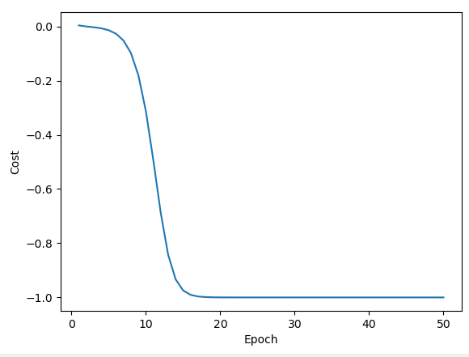
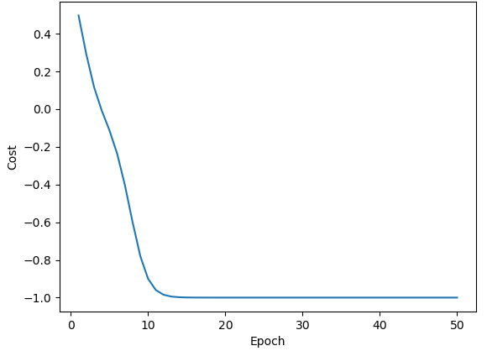


Experiments
With normal initialize for the pair $(φ_{1},φ_{2})$, 100 epoch, 0.4 learning rate, optimizer: GD, gradient by parameter – shift rule.
Init $φ$: [ 1.43609915 -1.48030143]
Init $φ$: [-0.51976105 0.66569928]
Solution: [ 2.83369713e-09 -3.14159265e+00]
Solution: [-4.44548300e-10 3.14159265e+00]

Slide 7
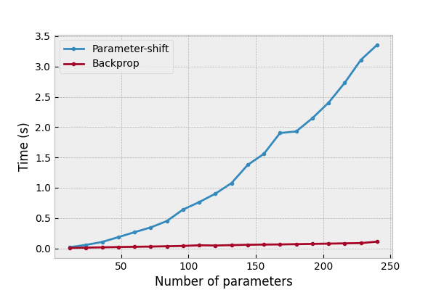

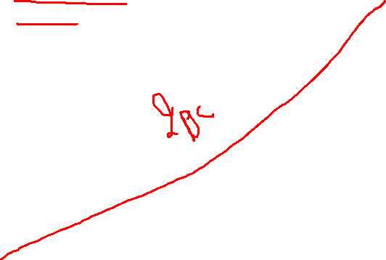
Quantum gradients
$$∂f\left(x\right)=r(f\left(x+ε\right)−f(x−ε))$$

Slide 8
